Slide 1
Welcome to Our Class Assembly

Slide 2
Roots of Empathy Themes
1. Meeting the baby.
2. Crying.
3. Caring and planning.
4. Emotions.
5. Sleep.
6. Safety.
7. Communicating.
8. Who am I?
9. Goodbye and Good Wishes.

Slide 3
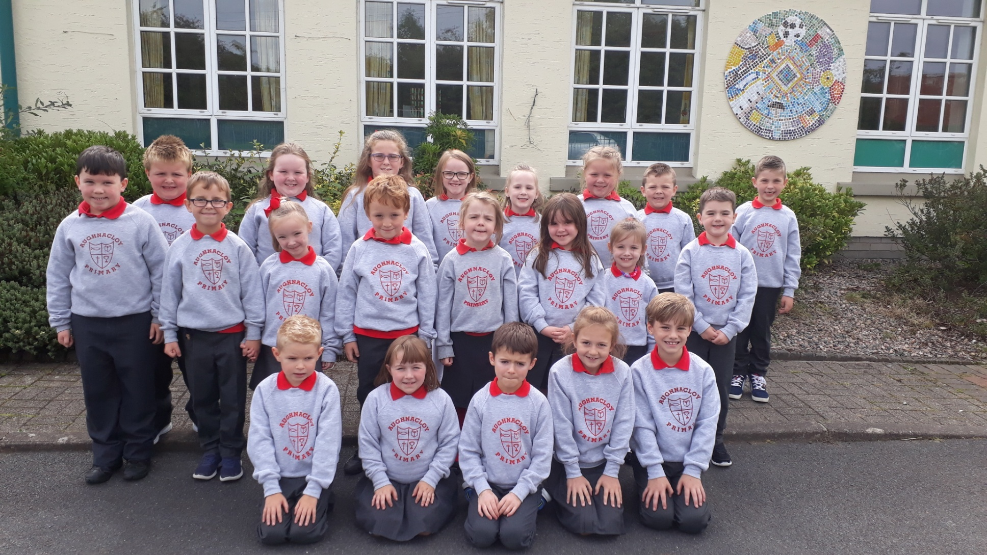
Meet our Class – Primary 3

Slide 4
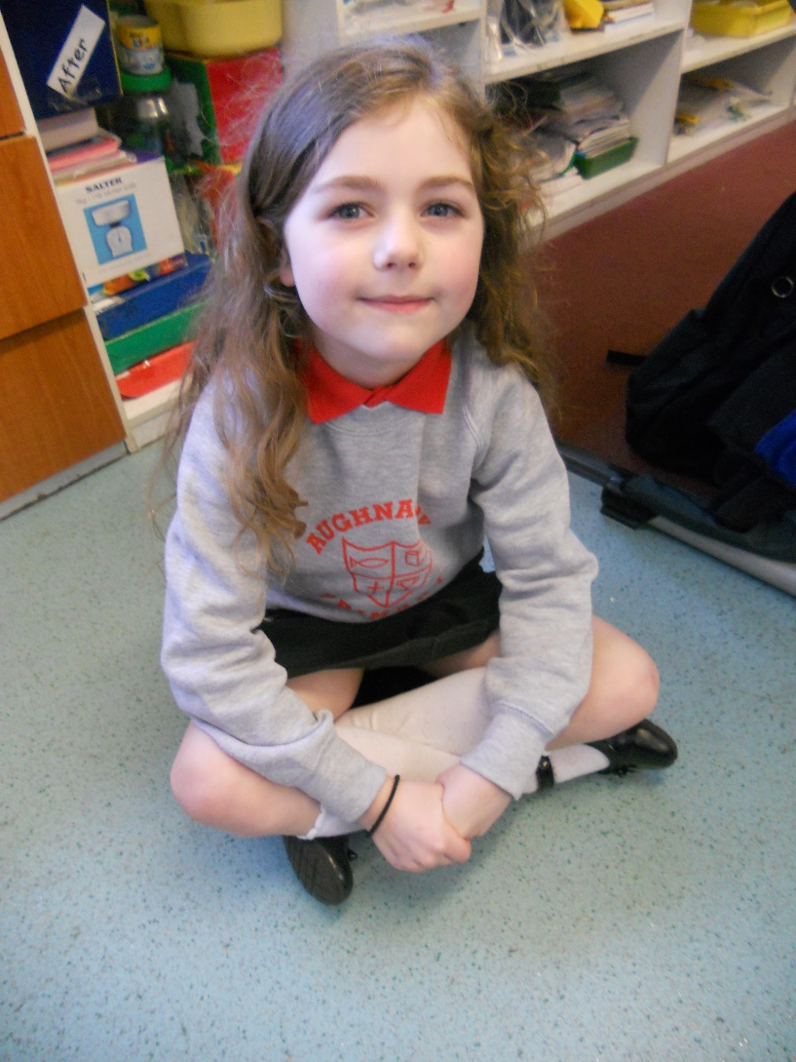
Summer-Rose Joined Us In January

Slide 5
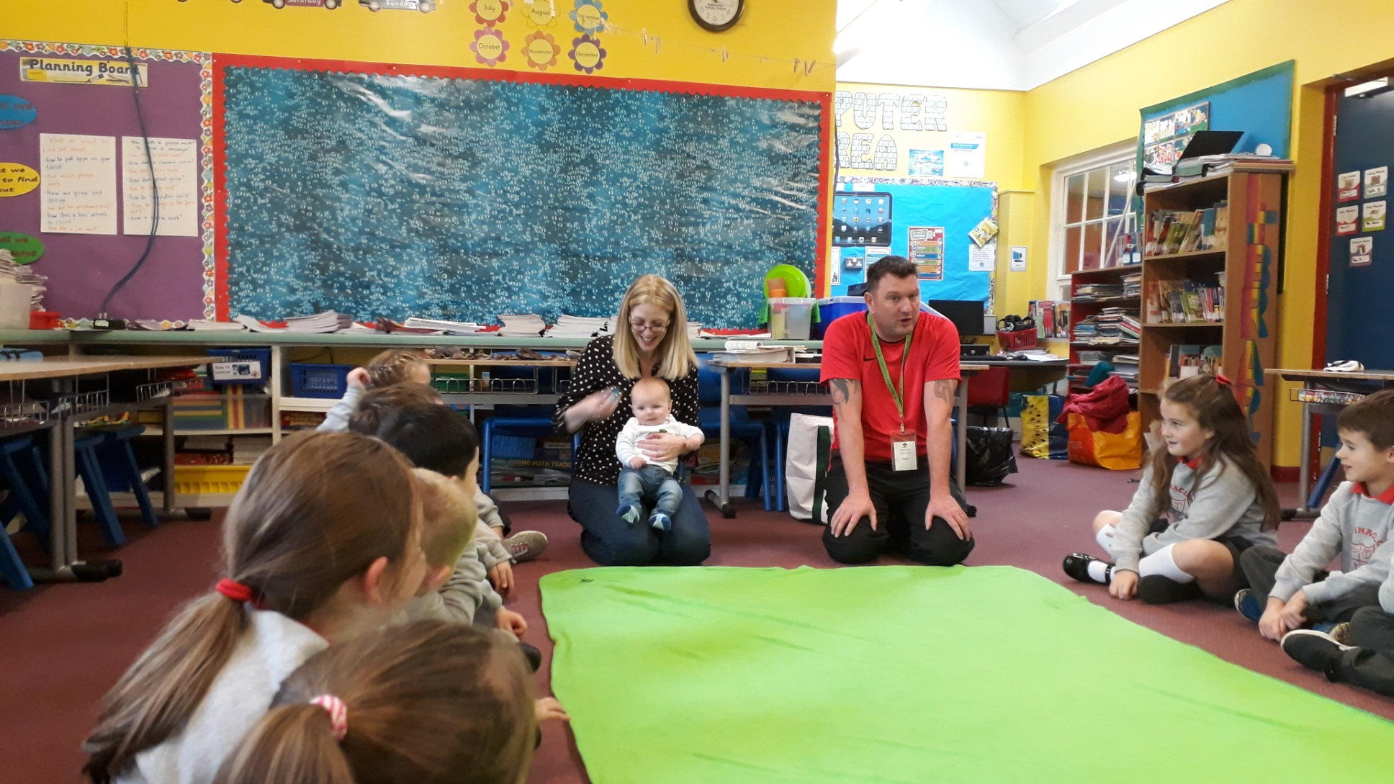
Baby Noah’s First Visit

Slide 6
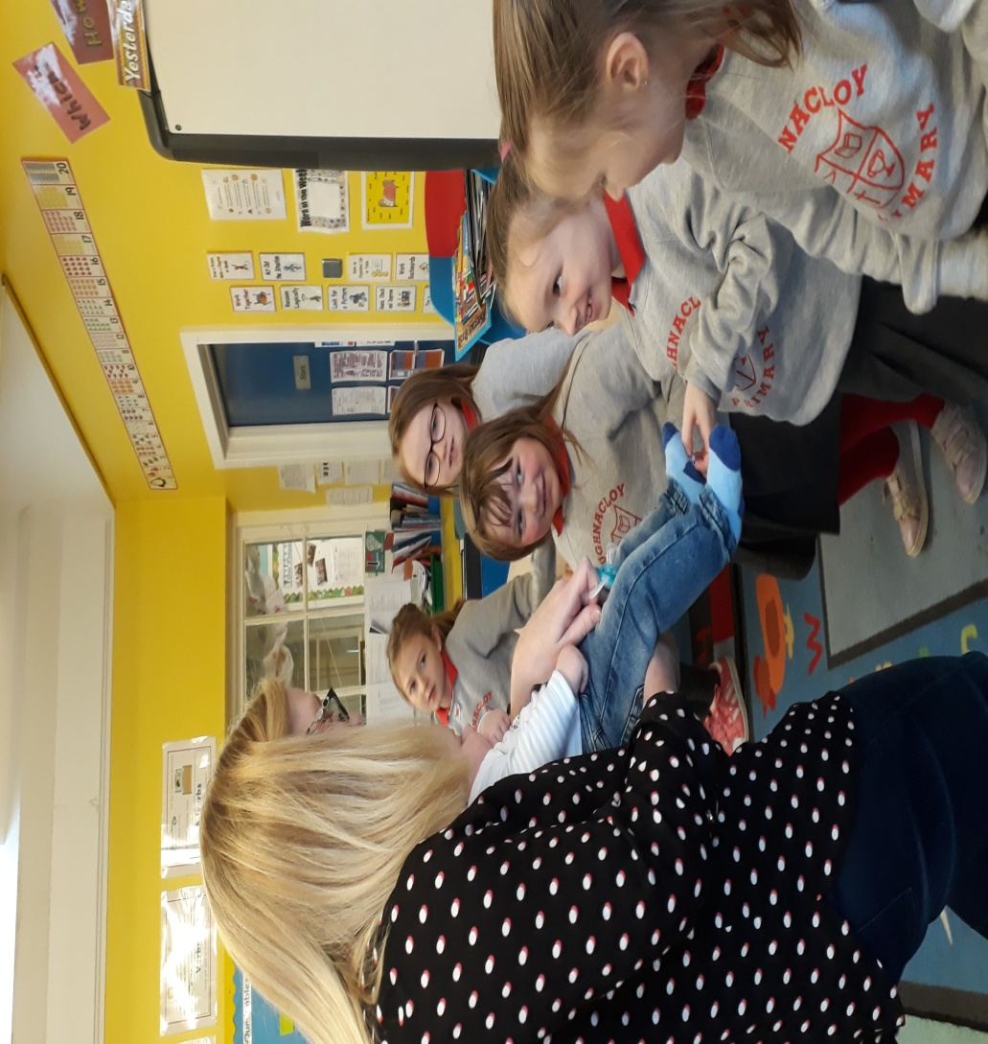
Singing the ‘Hello’ and ‘Goodbye’ Song

Slide 7
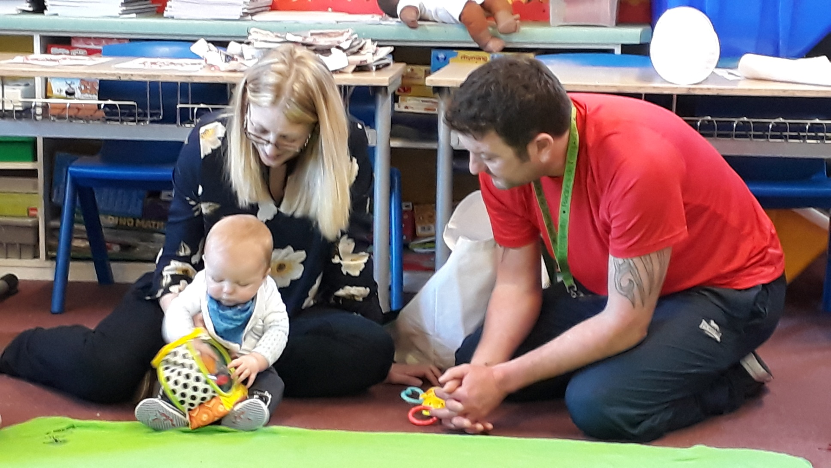
Baby Noah’s Second Visit

Slide 8
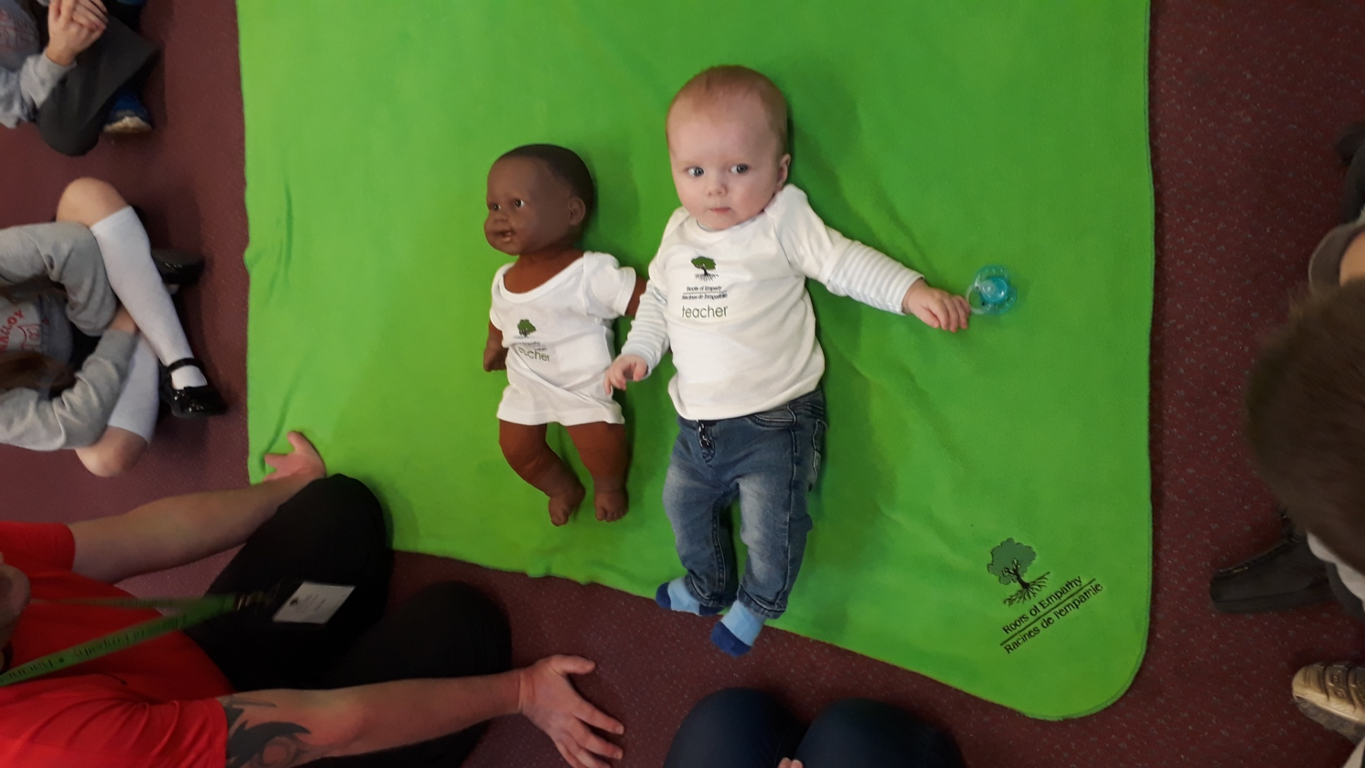
Measuring Baby Noah

Slide 9
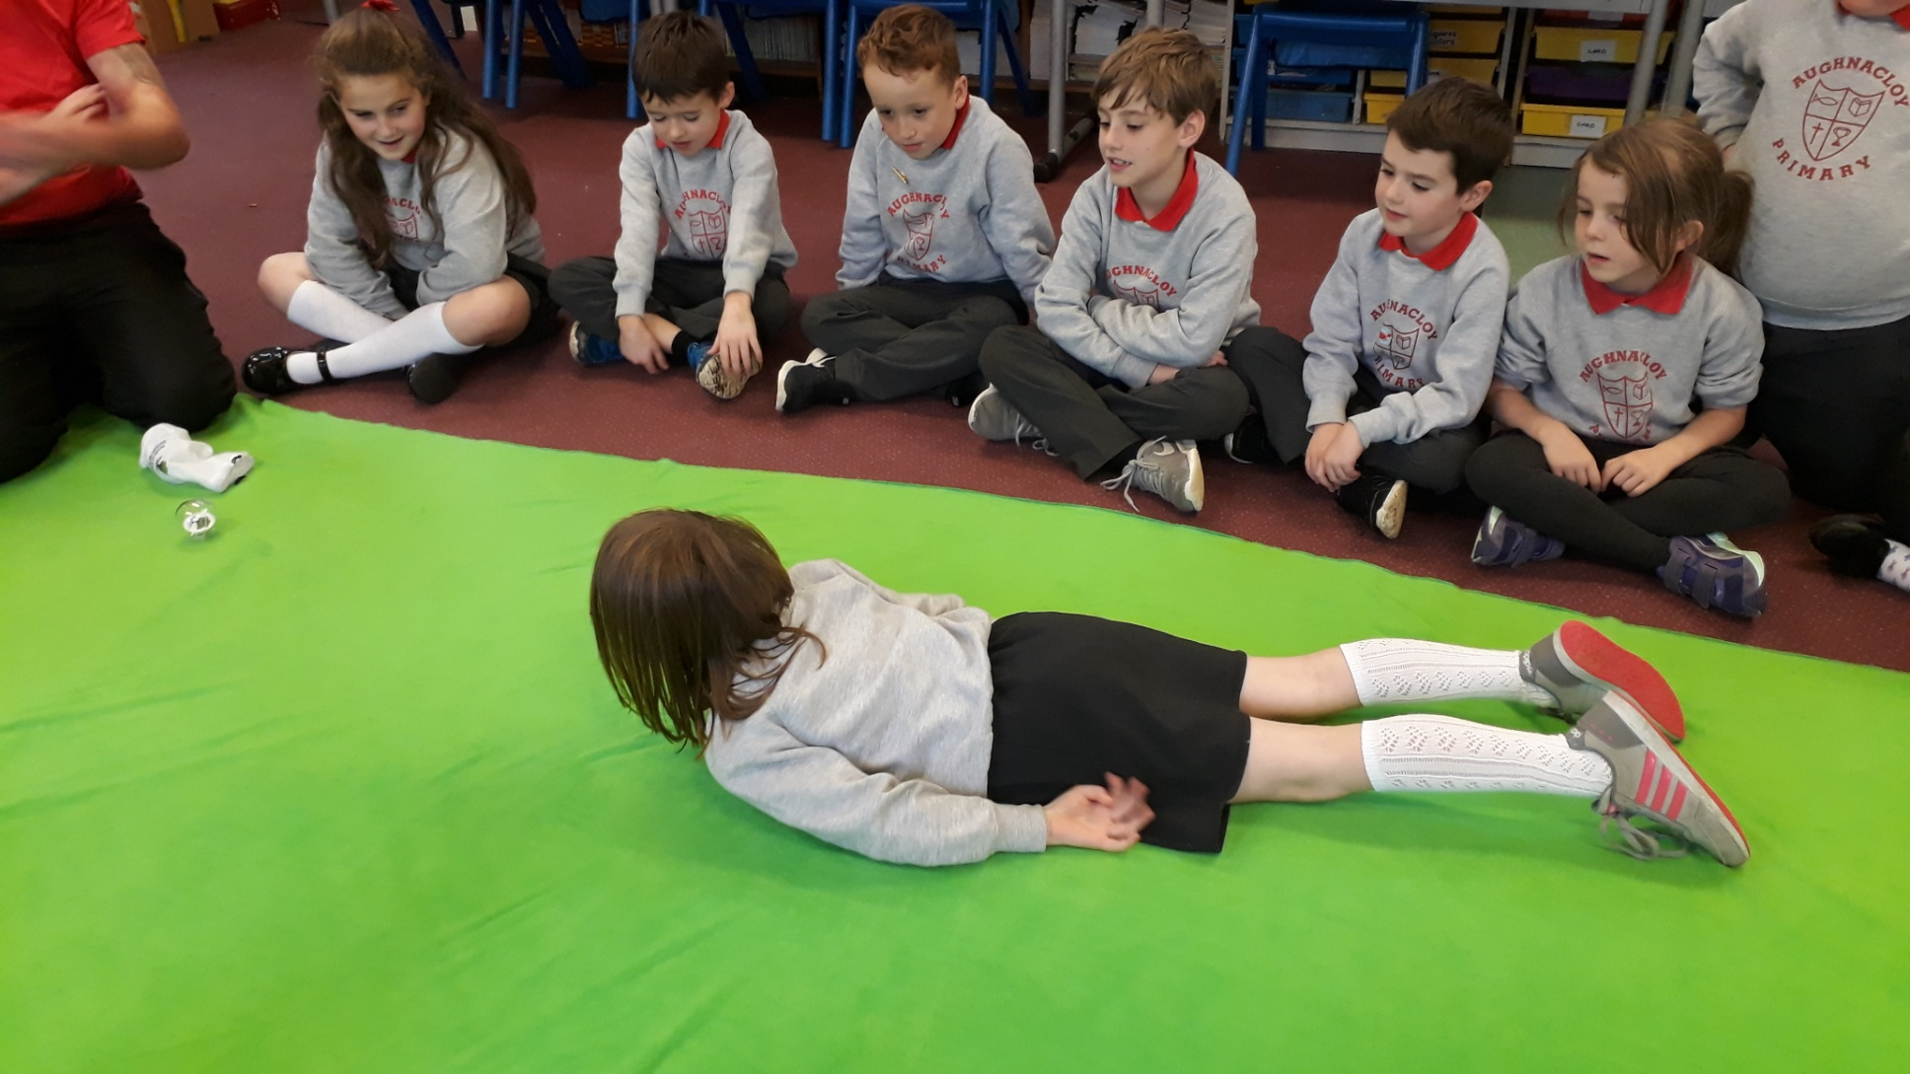
Tummy Time

Slide 10
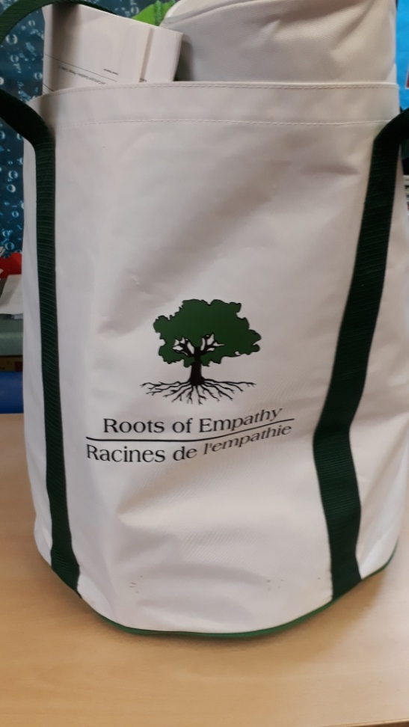
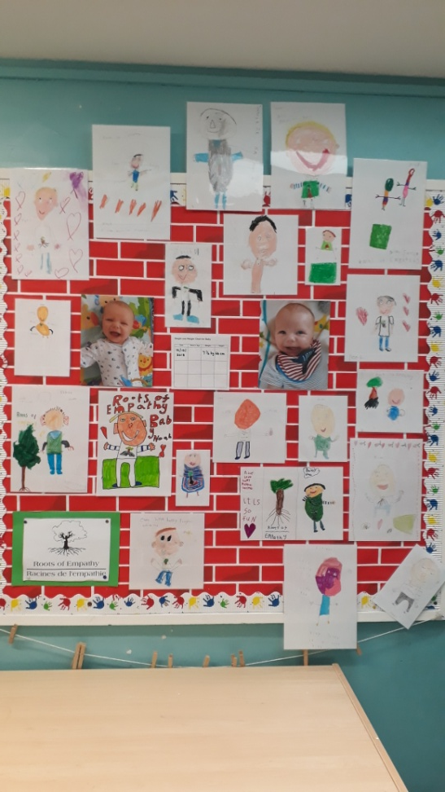
Our Roots of Empathy Board and Darren’s Bag of Toys

Slide 11
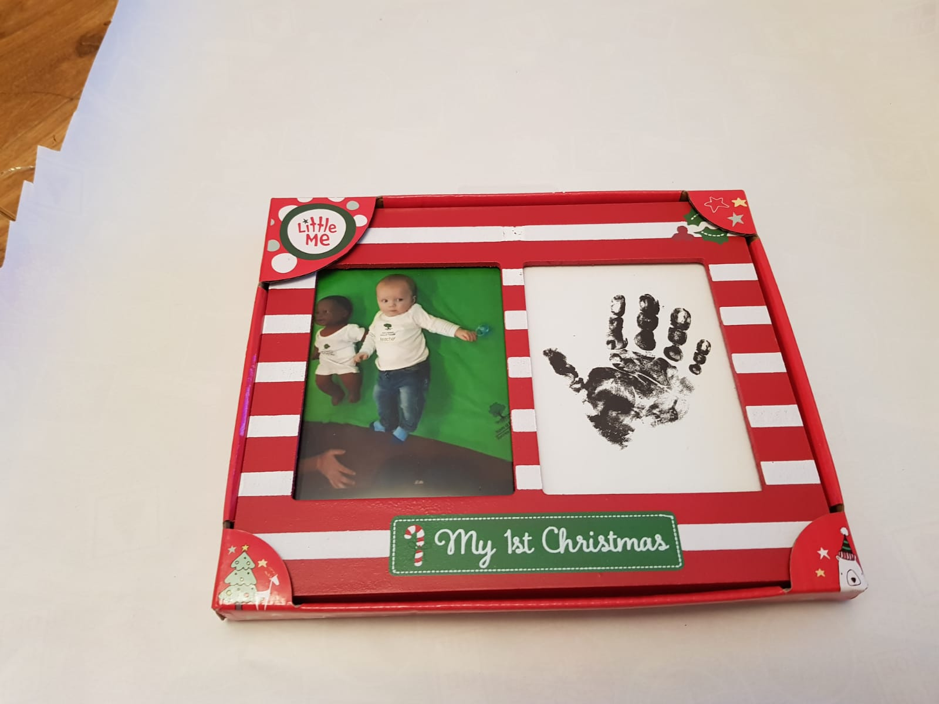
Baby Noah’s First Christmas

Slide 12
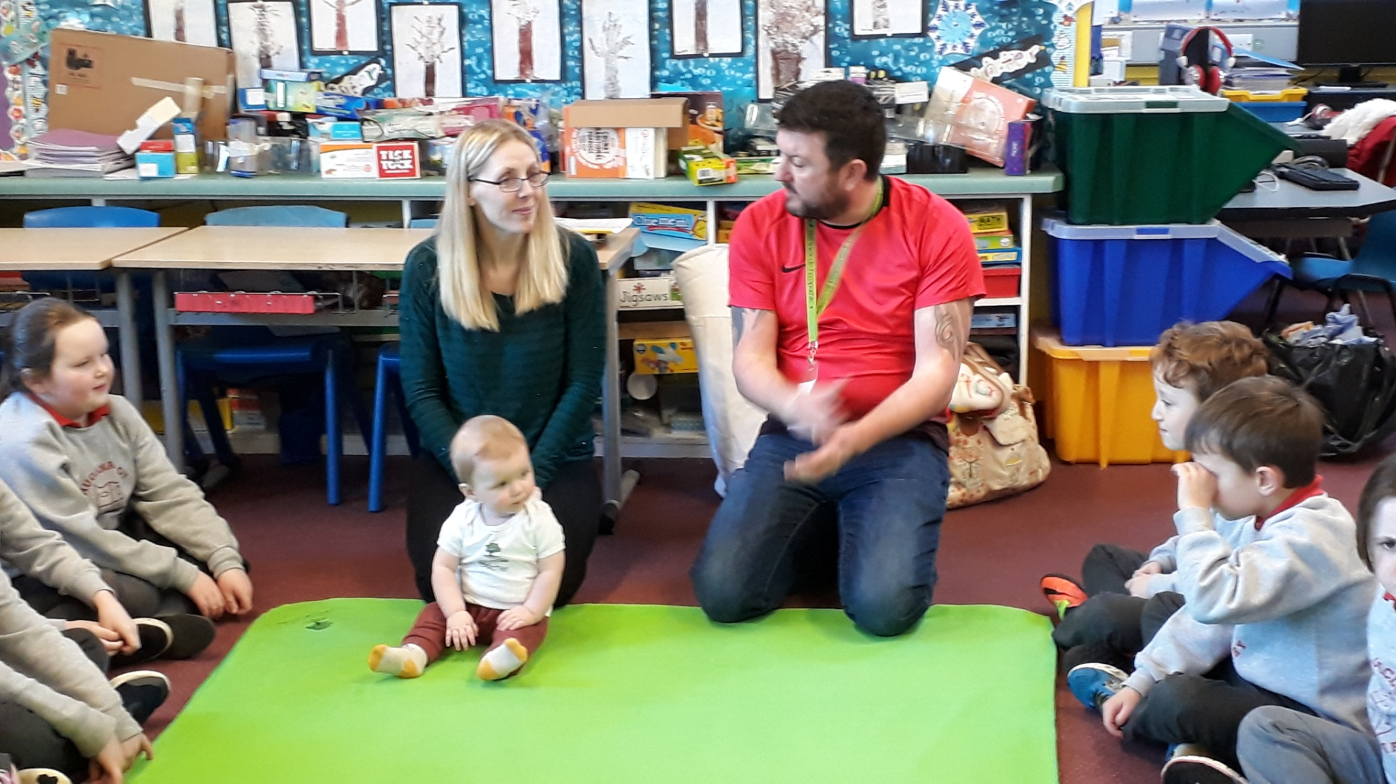
Milestone - Baby Noah can sit up!

Slide 13
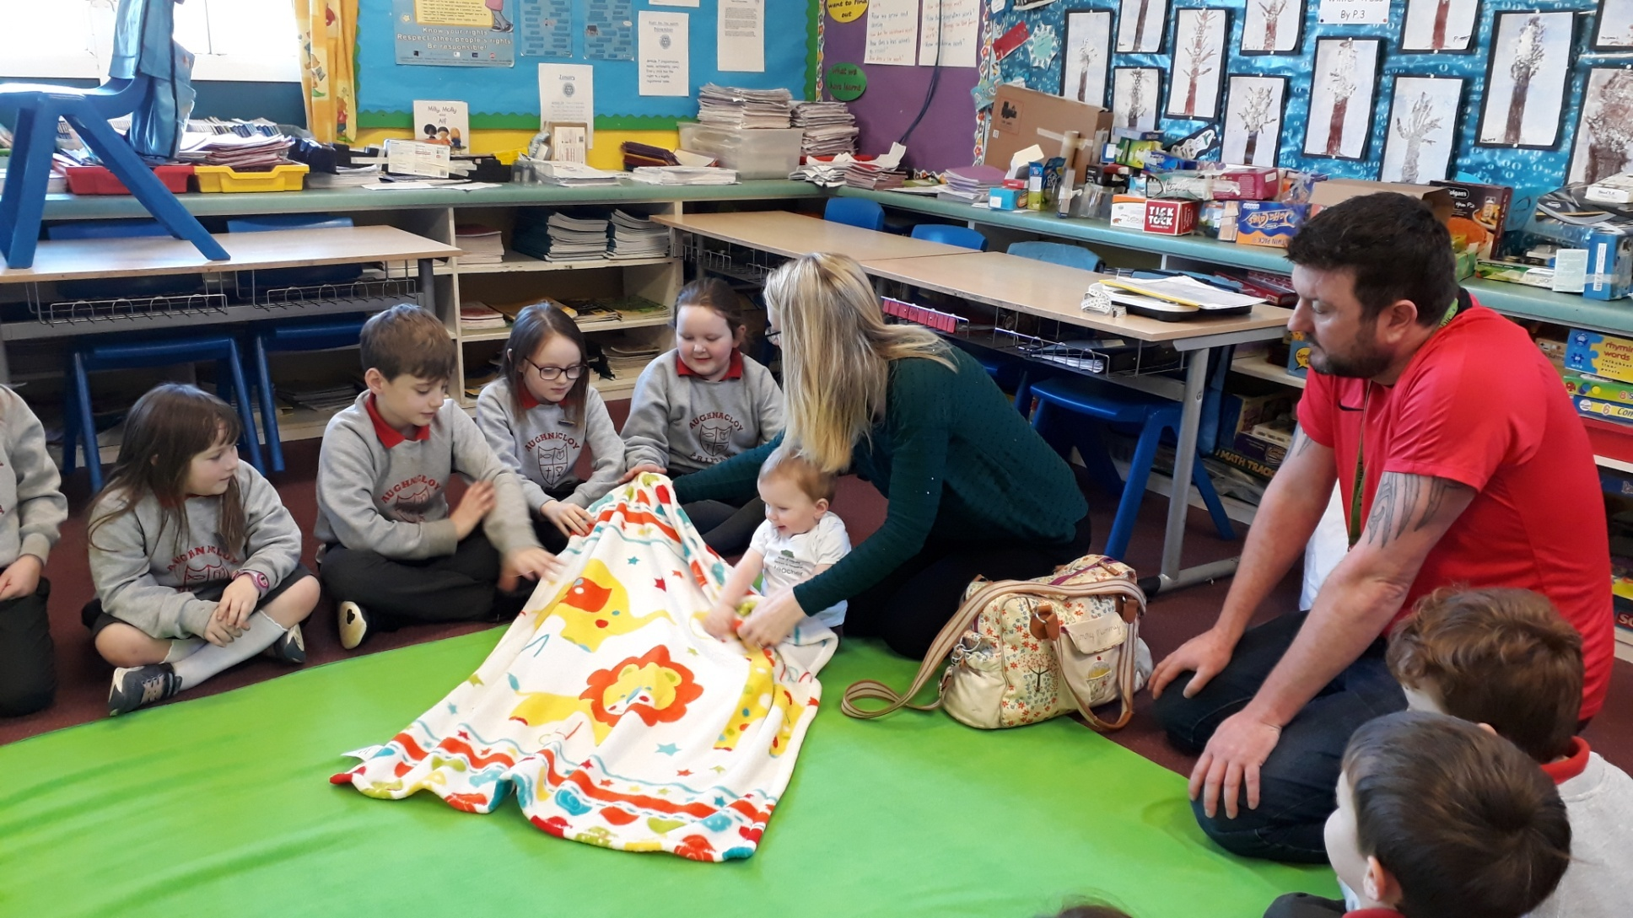
Sleep – Baby Noah’s Blanket

Slide 14
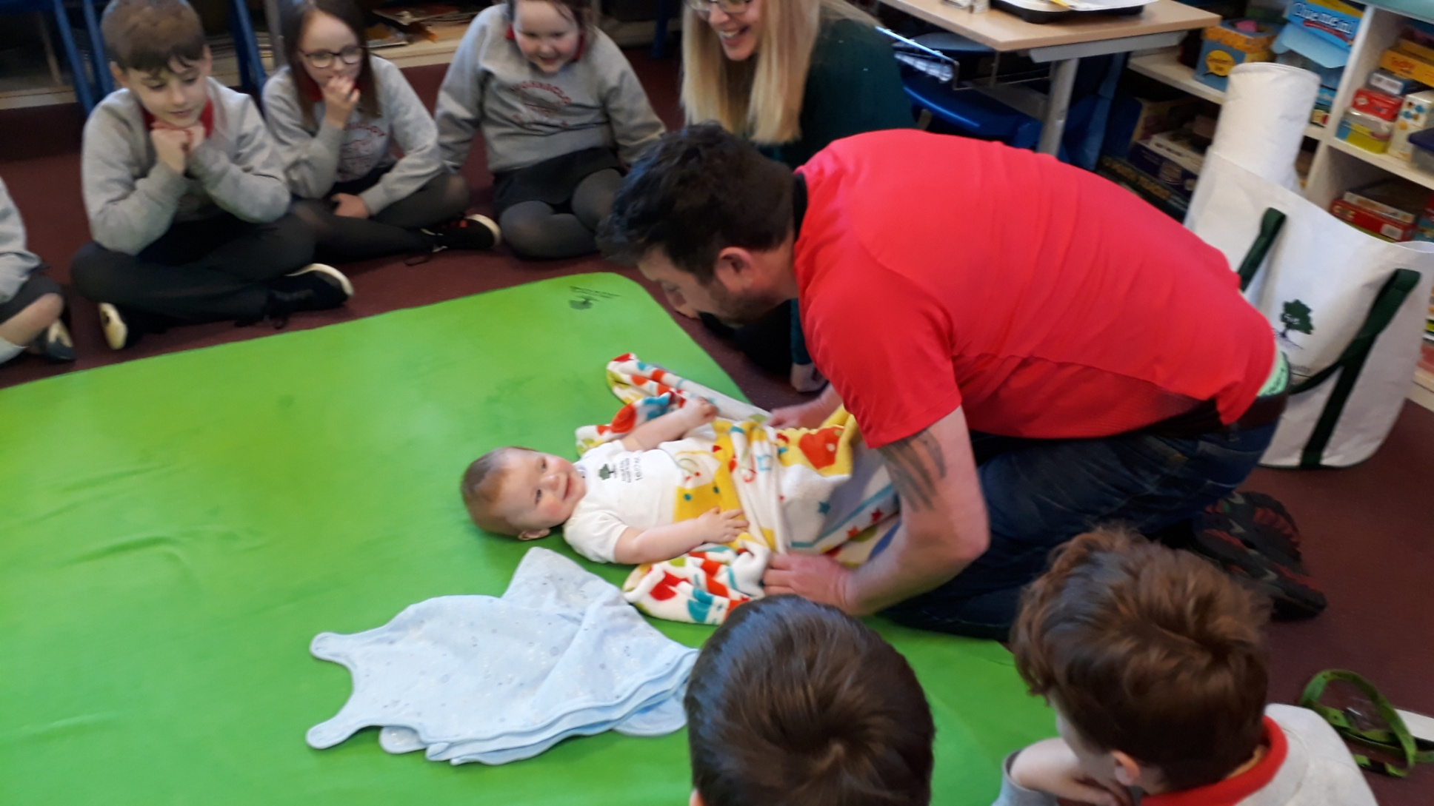
Playing Games – Peek A Boo!

Slide 15
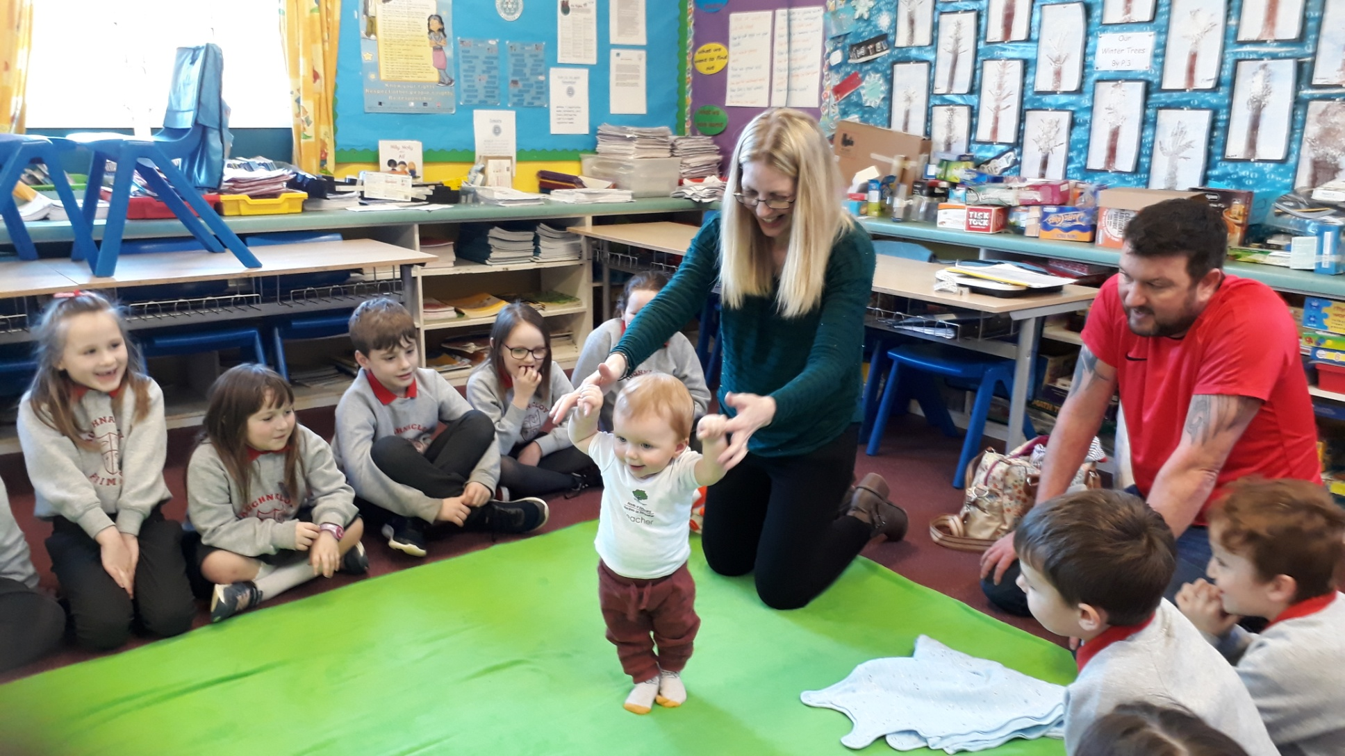
Milestones – Standing and holding Mummy’s hands to walk!

Slide 16
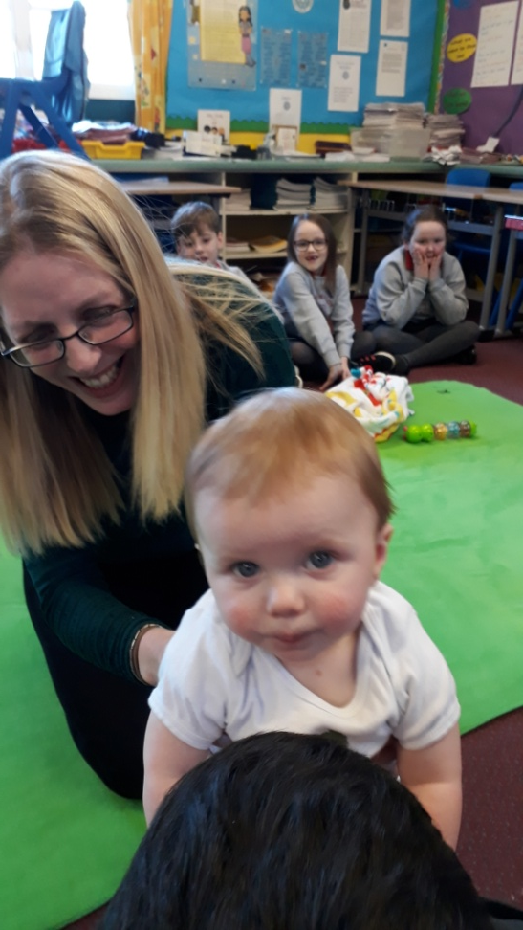
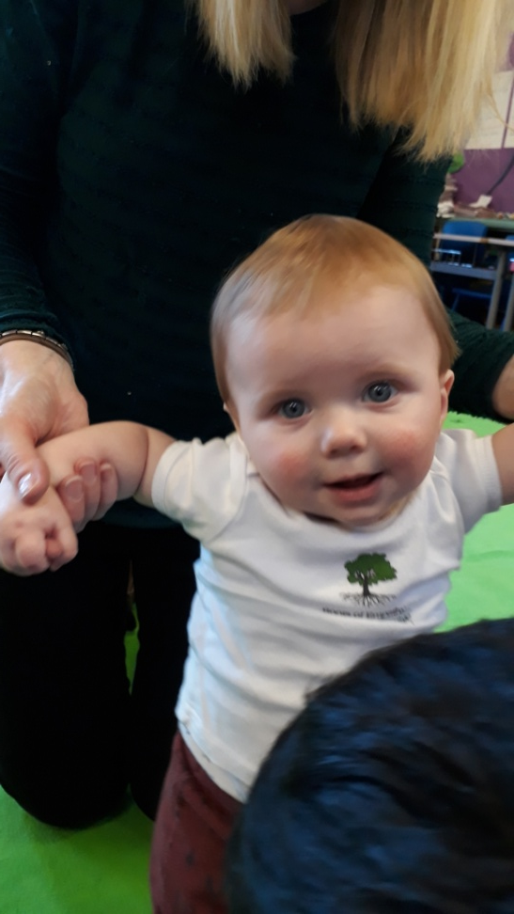
Noah Having Fun Showing Us How He Is Growing and Developing

Slide 17
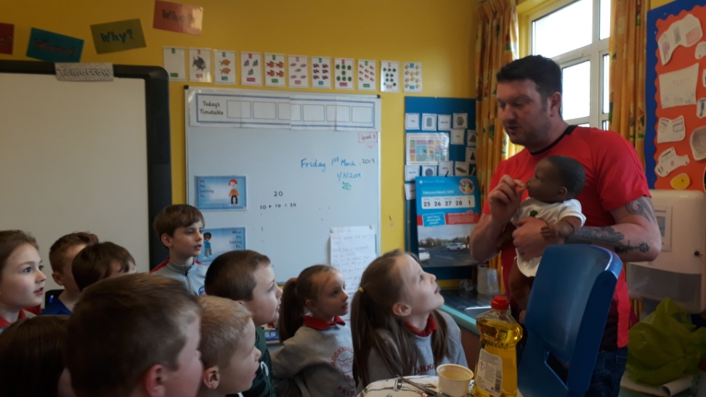
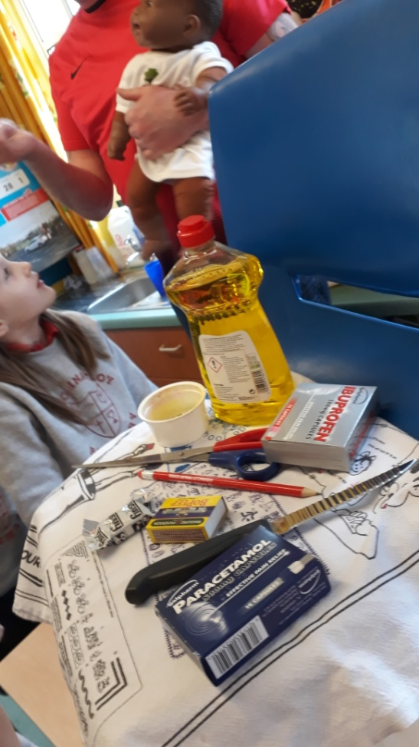
Theme - Safety

Slide 18
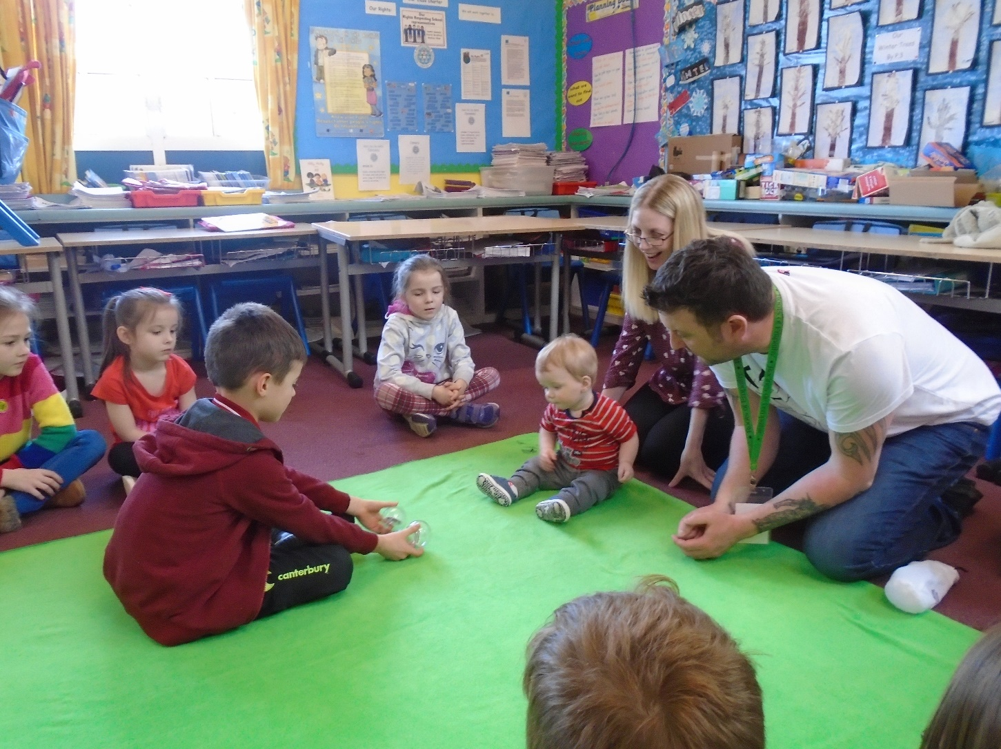
Baby Noah’s Recent Visit

Slide 19
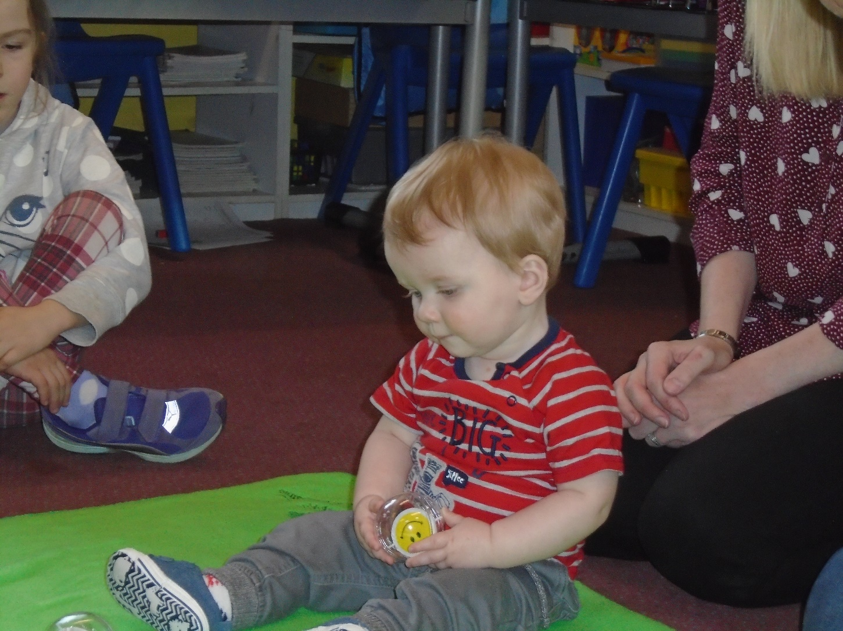
Noah Can Interact With Us

Slide 20
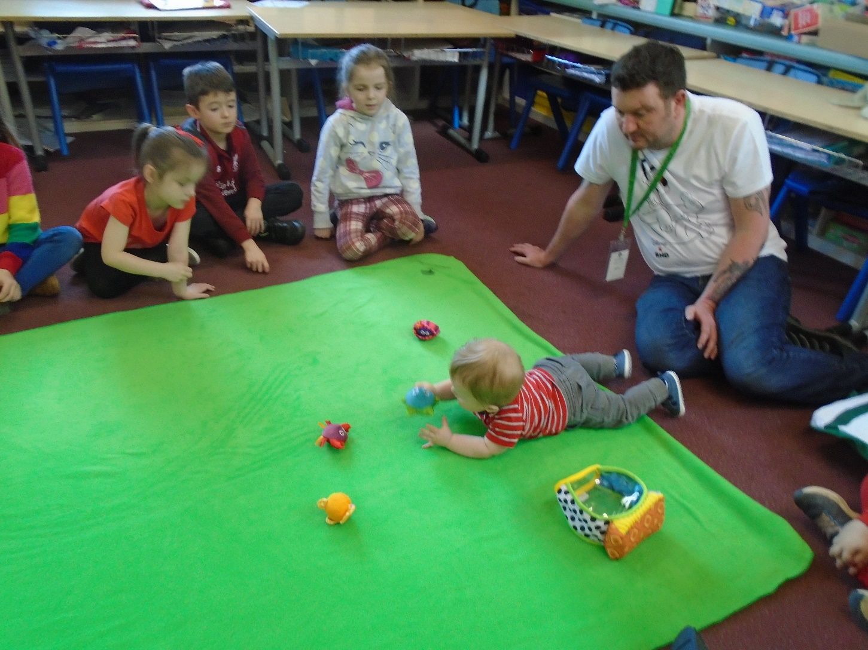
Noah Enjoys Playing With Toys

Slide 21
Roots of Empathy Themes
1. Meeting the baby.
2. Crying.
3. Caring and planning.
4. Emotions.
5. Sleep.
6. Safety.
7. Communicating.
8. Who am I?
9. Goodbye and Good Wishes.

